Slide 1
q-Processes in Modeling Coalescent with Recombination
马志明
2013-7-10,西南交大
Email: mazm@amt.ac.cn
http://www.amt.ac.cn/member/mazhiming/index.html

Slide 2
The talk is base on our recent two joint papers:
A Model for Coalescent with Recombination
Ying Wang¹, Ying Zhou², Linfeng Li³, Xian Chen¹, Yuting Liu³, Zhi-Ming Ma^{1,}*, Shuhua Xu^{2,}*
Markov Jump Processes in Modeling Coalescent with Recombination
Xian Chen¹, Zhi-Ming Ma¹, Ying Wang¹
¹: Academy of Math and Systems Science, CAS
²: CAS-MPG Partner Institute for Computational Biology
³: Beijing Jiaotong University,

Slide 3
Background : What is recombination?
Germ cells
Recombination is a process by which a molecule of nucleic acid (usually DNA, but can also be RNA) is broken and then joined to a different one.
Chromosome breaks up
gamete 1
gamete 2

Slide 4
Why study recombination?
An important mechanism generating and maintaining diversity
One of the main sources to provide new genetic material to let nature selection carry on
Mutation
Selection
Recombination

Slide 5
Application of recombination information
DNA sequencing
Identify the alleles that are co-located on the same chromosome
Disease study
Estimate disease risk for each region of genome
Population history study
Discover admixture history
Reconstruct human phylogeny

Slide 6
Basic model assumption
Wright-fisher model with recombination
The population has constant size N,
With probability 1-r, uniformly choose one parent to copy from (no recombination happens), with probability r, two parents are chosen uniformly at random, and a breakpoint s is chosen by a specified density (recombination event happens ).
Continuous model is obtained by letting N tends to infinity. Time is measured in units of 2N, and the recombination rate per gene per generation r is scaled by 2rN=constant. The limit model is a continuous time Markov jump process .

Slide 7
Model the sequence data
Without recombination
Sequence can be regarded as a point
With recombination
Sequence should be regarded as a vector or an interval

Slide 8
History (1)
Coalescent without recombination
Trace the ancestry of the samples
Markov jump process --Coalescent Process (Kingmann 1982)
A realization for sample of size 5

Slide 9
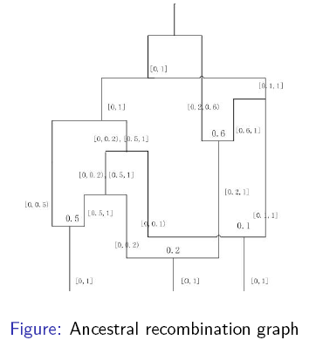
History (2) Coalescent with recombination
Back in time model
First proposed (Hudson 1983)
Ancestry recombination graph (ARG)
(Griffiths R.C., Marjoram P. 1997)
Software: ms (Hudson 2002)
Spatial model along sequences
Point process along the sequence
(Wuif C., Hein J. 1999)
Approximations: SMC(2005)、
SMC’(2006)、MaCS(2009)
Resulting structure: ARG

Slide 10
Algorithm generating ARGs can be of great use.
can be applied to exploratory data analysis.
Samples simulated under various models can be combined with data to test hypotheses.
can be used to estimate recombination rate.
The question of whether recombination events are clustered in hotspots is of enormous interest at present, and also unambiguously has great relevance in the efficient design of association studies[5].

Slide 11
Back in time model
Merit
Due to the Markov property, it is computationally straightforward and simple
Disadvantage
It is hard to make approximation, hence it is not suitable for large recombination rate

Slide 12
Spatial model along sequences
Merits
- the spatial moving program is easier to approximate
- approximations: SMC(2005)、SMC’(2006)、 MaCS(2009)
Disadvantages
- it will produce redundant branches
- complex non-Markovian structure
- the mathematical formulation is cumbersome and up to date no rigorous mathematical formulation

Slide 13
Our model: SC algorithm
SC is also a spatial algorithm
SC does not produce any redundant branches which are inevitable in Wuif and Hein’s algorithm.
Existing approximation algorithm (SMC, SMC’, MaCS) are all special cases of our model.

Slide 14
Rigorous Mathematical Model
We prove rigorously for the first time that the statistical properties of the ARG generated by our spatial moving model and that generated by a back in time model are the same: they share the same probability distribution on the space of ARG
Provides a unified interpretation for the algorithms of simulating coalescent with recombination.

Slide 15
Mathematical models
Markov jump process behind back in time model
- state space
- existence of Markov jump process
- sample paths concentrated on G
Point process corresponding to the spatial model
- construct on G
- projection of q-processes
- distribution of
Identify the probability distribution

Slide 16
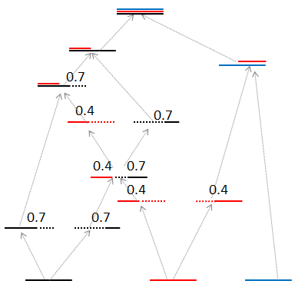
Back in time model
Starts at the present and performs backward in time generating successive waiting times together with recombination and coalescent events until GMRCA (Grand Most
Recent Common Ancestor)

Slide 17
State space of the process
0.4
$f_{1}=\left\{1\right\}I_{[0,0.4)}$, $f_{2}=\left\{2\right\}I_{[0,0.4)}\text{+}\left\{1,2\right\}I_{[0.4,1)}$, $f_{3}=\left\{3\right\}I_{[0,1)}$
0.4
0.4
$f_{1}=\left\{1\right\}I_{[0,0.4)}$, $f_{2}=\left\{1\right\}I_{[0.4,1)}$, $f_{3}=\left\{2\right\}I_{[0,1)}$, $f_{4}=\left\{3\right\}I_{[0,1)}$
$f_{1}=\left\{1\right\}I_{[0,1)}$, $f_{2}=\left\{2\right\}I_{[0,1)}$, $f_{3}=\left\{3\right\}I_{[0,1)}$

Slide 18
State space of the process
Let $P$ be the collection of all the subsets of $\left\{1,2,…,N\right\}$.
$S_{\left[0,1\right)}(P)$ be all the $P$-valued right continuous piecewise constant functions on $\left[0,1\right)$ with at most finite many discontinuous points.
$f∈S_{\left[0,1\right)}(P)$ can be expressed as $f=\sum_{j=0}^{m}{f\left(a_{j}\right)I_{[a_{j, }a_{j+1})}}$ with $0=a_{0}<a_{1}<⋯<a_{m}<a_{m+1}=1$

Slide 19
Introduce suitable metric on E

Slide 21
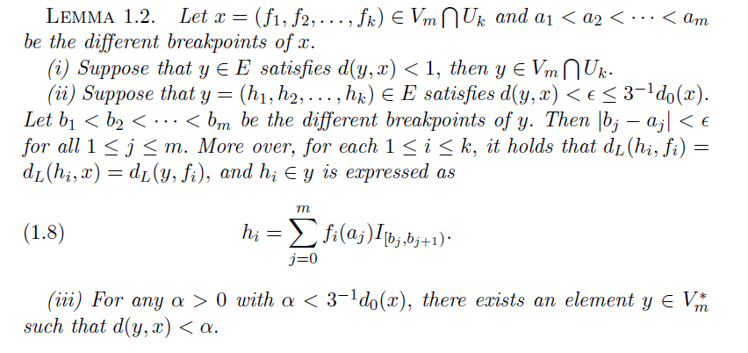
E is a locally compact separable metric space

Slide 22
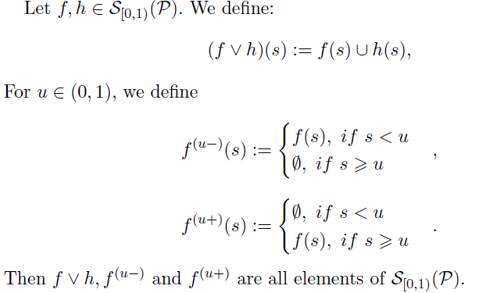
Introduce suitable operators on E
coalescence
recombination

Slide 23
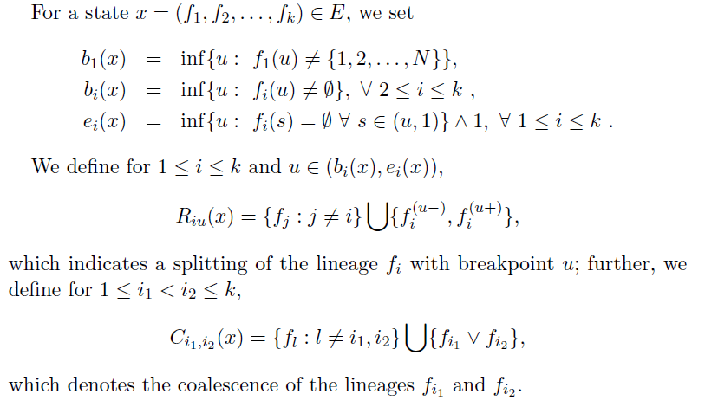
Introduce suitable operators on E
avoiding
redundant
recombination
coalescence

Slide 24
Existence of the Markov Jump Process
Define further
Key point: prove that

Slide 25
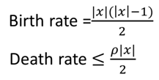
Existence of the q-process
Intuitively the q-process will arrive at the absorbing state in at most finite many jumps.
A rigorous proof needs order-preserving coupling

Slide 26
Uniqueness of the q-process

Slide 27
Uniqueness of the q-process
Theorem 2.25 in [Chen 2004]
One can check that our q-process satisfies
the above condition.

Slide 28
Monotonicity (application of order preserving coupling)

Slide 29
Define
$$P_{1}\left(t,x,\left\{∆\right\}\right)→1 as t→∞$$

Slide 30
Monotonicity (application of order preserving coupling)
We define
By [Chen 2004] Th.5.47 one can check that
X(t) will almost surely arrive
at in at most finite many jumps

Slide 31
Monotonicity (application of order preserving coupling)
Hypothesis 5.46 in [Chen 2004]
Theorem 5.47 in [Chen 2004]:

Slide 32
ARG Space G
: all the E-valued right continuous
piecewise constant functions with at
most finite many discontinuity points.
if it satisfies:

Slide 34
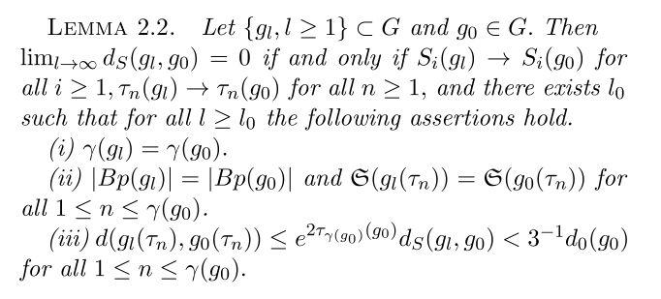

Slide 35
ARG Space G

Slide 36
Spatial Model along Sequences
Spatial model begins with a coalescent tree at
the left end of the sequence.
Adds more different local trees gradually along the sequence, which form part of the ARG.
The algorithm terminates at the right end of the sequence when the full ARG is determined.

Slide 37
Point process $\left\{S_{i}，Z^{i}：i≥0\right\}$ corresponding to spatial model: construct $\left\{S_{i}，Z^{i}：i≥0\right\}$ on $G$
0.7
0.4
0.7
0.4
0.7
0.4
0.4
0.7
0.7

Slide 38
Point process $\left\{S_{i}，Z^{i}：i≥0\right\}$ corresponding to spatial model: construct $\left\{S_{i}，Z^{i}：i≥0\right\}$ on $G$
0.7
0.4
0.7
0.4
0.7
0.4
0.4
0.4
0.7
0.7

Slide 39
Point process $\left\{S_{i}，Z^{i}：i≥0\right\}$ corresponding to spatial model: construct $\left\{S_{i}，Z^{i}：i≥0\right\}$ on $G$
0.7
0.4
0.7
0.4
0.7
0.4
0.4
0.7
0.7
0.7
0.4

Slide 40
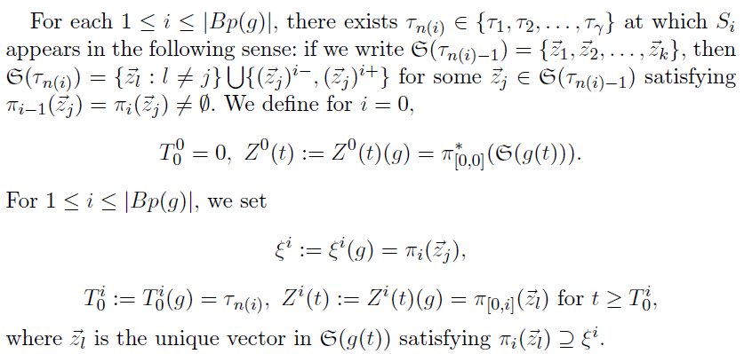

Slide 41
To determine , we set
We need only to determine :

Slide 42
Point process $\left\{S_{i}，Z^{i}：i≥0\right\}$ corresponding to spatial model: construct $\left\{S_{i}，Z^{i}：i≥0\right\}$ on $G$
0.7
0.4
0.7
0.4
0.7
0.4
0.4
0.7
0.7

Slide 43
Point process $\left\{S_{i}，Z^{i}：i≥0\right\}$ corresponding to spatial model: construct $\left\{S_{i}，Z^{i}：i≥0\right\}$ on $G$
0.7
0.4
0.7
0.4
0.7
0.4
0.4
0.4
0.7
0.7

Slide 44
Point process $\left\{S_{i}，Z^{i}：i≥0\right\}$ corresponding to spatial model: construct $\left\{S_{i}，Z^{i}：i≥0\right\}$ on $G$
0.7
0.4
0.7
0.4
0.7
0.4
0.4
0.7
0.7
0.7
0.4

Slide 45
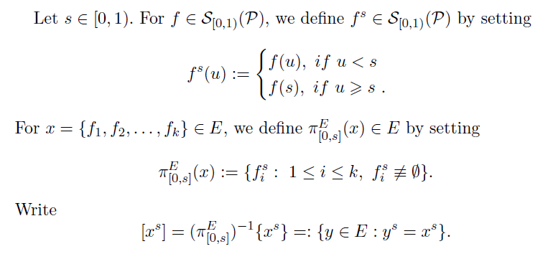
Projection of q-processes

Slide 46
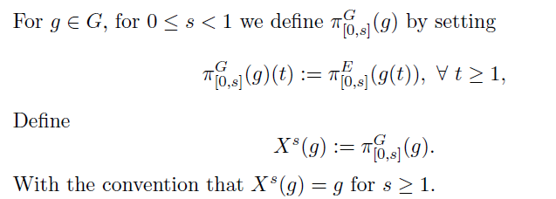
Projection of q-processes
a Markov jump process ?

Slide 47
A general result on q-processes
a classical result !

Slide 48
Sketch of the proof:
Let

Slide 49
In the proof we need the following result:
Proof:
Following the arguments used in Theorem 1.5 and
Theorem 1.13 of [Chen2004].

Slide 50
Projection of q-processes
Sketch of the proof :
Construct approximate bounded q-process
and use Proposition 3.3

Slide 51
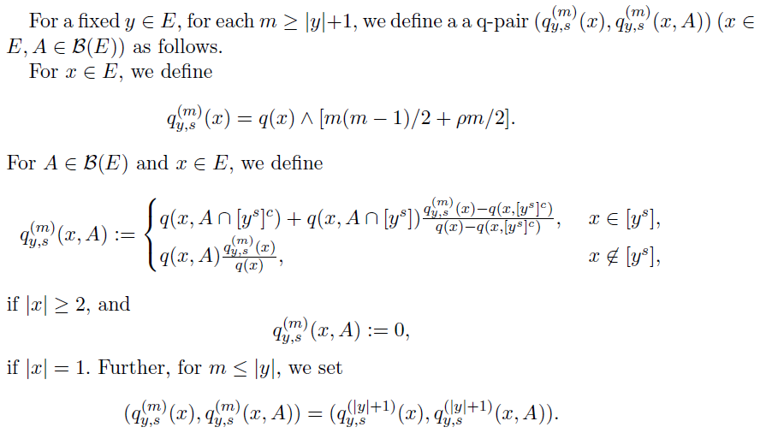

Slide 52
Projection of q-processes
is a time homogenous
Markov jump process !

Slide 53
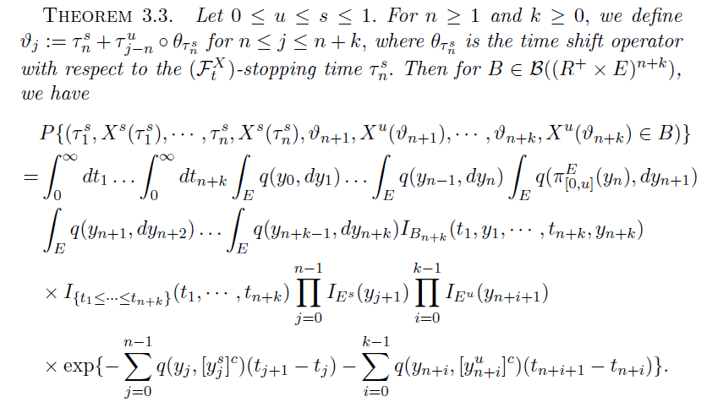
Point process $\left\{S_{i}，Z^{i}：i≥0\right\}$ corresponding to spatial model: thinning of the point process

Slide 54
Waiting time is exponentially distributed with parameter
depends on the total length of the current local tree

Slide 55
Point process $\left\{S_{i}，Z^{i}：i≥0\right\}$ corresponding to spatial model: the distribution of $\left\{S_{i}，Z^{i}：i≥0\right\}$
Sketch of the proof :
Step 1:

Slide 56
Point process $\left\{S_{i}，Z^{i}：i≥0\right\}$ corresponding to spatial model: the distribution of $\left\{S_{i}，Z^{i}：i≥0\right\}$
Step 2: Let $α_{m}=2^{−m}([{2_{}^{m}S}_{i}$]+1), calculate
Step 3: Approximation

Slide 57
Point process $\left\{S_{i}，Z^{i}：i≥0\right\}$ corresponding to spatial model: the distribution of $\left\{S_{i}，Z^{i}：i≥0\right\}$
The position of on the current local tree
is uniformly distributed on the local tree

Slide 58
Point process $\left\{S_{i}，Z^{i}：i≥0\right\}$ corresponding to spatial model: the distribution of $\left\{S_{i}，Z^{i}：i≥0\right\}$
Sketch of the proof:
Step 1: Let $α_{m}=2^{−m}([{2_{}^{m}S}_{i}$]+1), $σ_{n}=2^{−n}([{2_{}^{n}S}_{i}$]+1). Define
Then one can check that

Slide 59
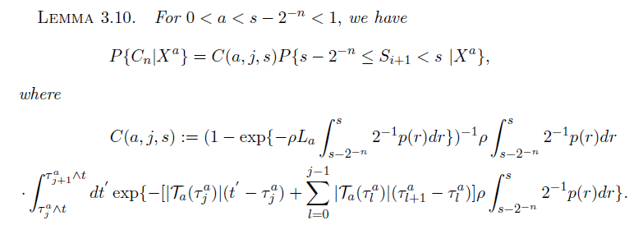
Point processes $\left\{S_{i}，Z^{i}：i≥0\right\}$ corresponding to spatial model: the distribution of $\left\{S_{i}，Z^{i}：i≥0\right\}$
Step 2:

Slide 60
Point process $\left\{S_{i}，Z^{i}：i≥0\right\}$ corresponding to spatial model: the distribution of $\left\{S_{i}，Z^{i}：i≥0\right\}$
The proof is cumbersome and complicated.

Slide 61
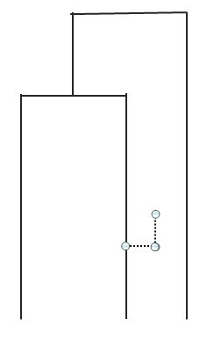
Point process $\left\{S_{i}，Z^{i}：i≥0\right\}$ corresponding to spatial model: the distribution of $\left\{S_{i}，Z^{i}：i≥0\right\}$
It will coalesce to any existing branches independently with rate 1.

Slide 62
Point processes $\left\{S_{i}，Z^{i}：i≥0\right\}$ corresponding to spatial model: the distribution of $\left\{S_{i}，Z^{i}：i≥0\right\}$
It will move along the branch and leave it with rate

Slide 63
Point process $\left\{S_{i}，Z^{i}：i≥0\right\}$ corresponding to spatial model: the distribution of $\left\{S_{i}，Z^{i}：i≥0\right\}$
If it does not leave the branch before $ε\left(g\right)$, it will move along to the next branch.

Slide 64
SC algorithm
$X^{0}$ : a standard coalescent
$S_{i}$ : the $i$th recombination point
$X^{S_{i}}$: the ARG constrained on ${[0,S}_{i}]$
$Z^{i}$: the extra branched on $X^{S_{i}}$ than $X^{S_{i−1}}$
The whole ARG can be considered as a point process $\left\{{(S}_{i},Z^{i}\right):i≥0\}.$

Slide 65
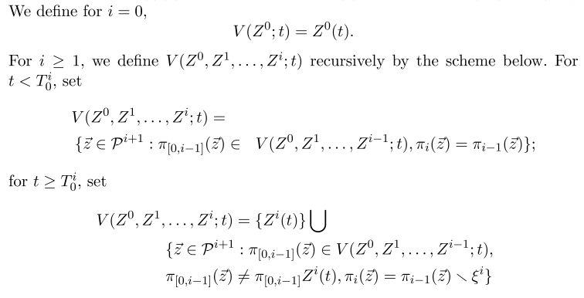
Identical probability distribution of the back in time model and spatial model

Slide 66
Identical probability distribution of the back in time model and spatial model

Slide 67
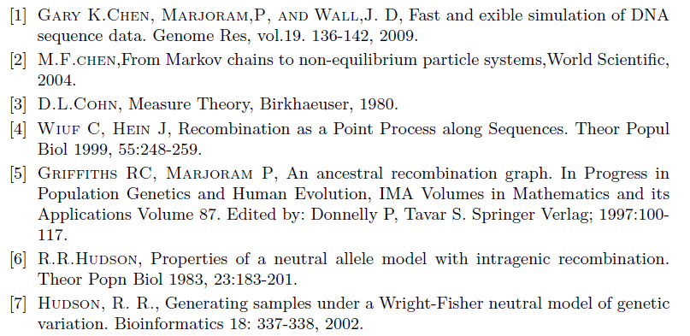
References

Slide 68
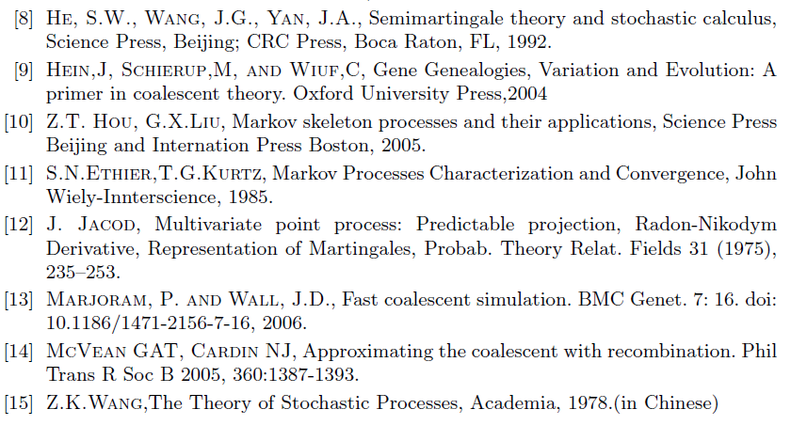
References

Slide 69
Thank you !

